Slide 1
IoT Network

Slide 2
Overview
Describe how information/data travels through an IoT network;
List the components of a basic network, and their properties;
Describe the types of connections in IoT networks;
Understand the role of Internet Protocol and describe how their various properties make them suited to different types of IoT projects.

Slide 3
Network and Protocols
IoT application protocols have been built upon the variety of network protocols such as OSI, TCP/IP, HTTP...
All networking and IoT protocols are open and standardized by independent committees and working groups like the IETF or ISO.

Slide 4
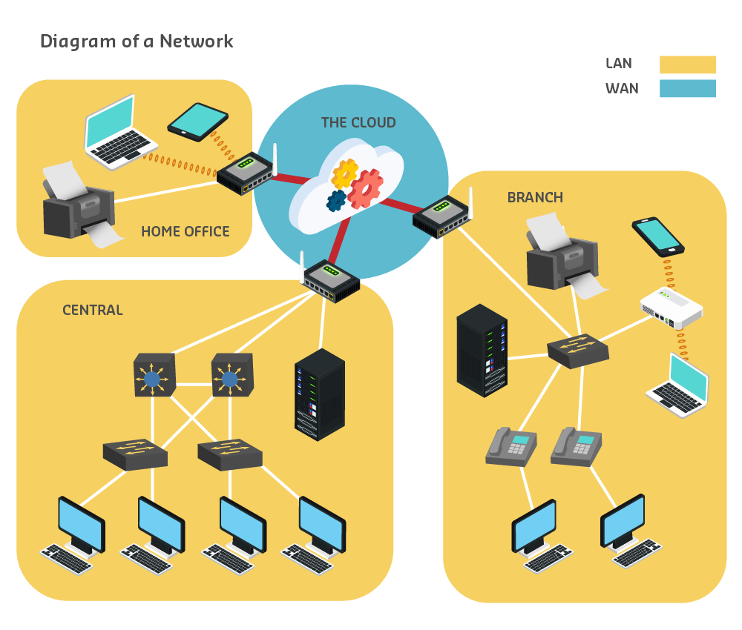
Networks
Networks allow us to communicate information and collect data from sensors.

Slide 5
Network key components
The simple network has several key components:
Devices - includes the computers, printers, routers and servers.
Media - includes the cabling or wireless connections.
Services - includes the software that support operations, such as email hosting.

Slide 6
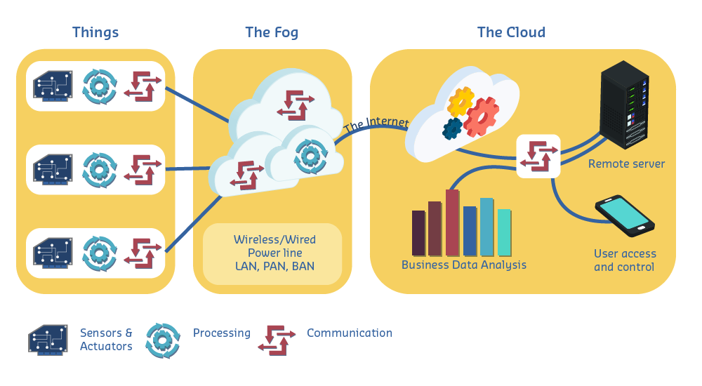
Wired, local communication networks
The interconnection between IoT devices occurs at two main levels: local and long distance (the Internet).
The following diagram shows the IoT from a communications point of view.

Slide 7
Gateways and routing
Communication in the network is carried through a medium – currently this means via either a cable (for example, metallic wires in copper cables, or glass or plastic fibres in fibre optic cables) or the air (wireless transmission).
The different media have different characteristics, which makes each better suited to different circumstances, taking into consideration factors such as:
the distance a signal needs to travel
the environment it is travelling in
the amount and speed of the data
the cost of the media and its installation.
The IoT adds even more circumstances and considerations for connectivity...making the ‘world wide web’ look more like a web than ever before.

Slide 8
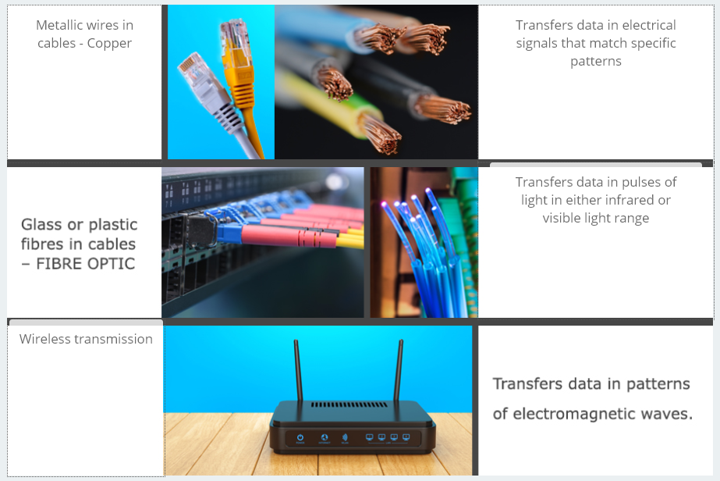
Different types of media
Notes:
Infrared: Tia hong ngoai
ElectroMagnetic waves: Song điện từ

Slide 9
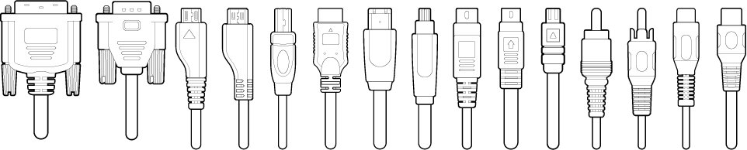
Communication protocols
In all IoT ecosystems, devices communicate using binary protocols, meaning that all information is transmitted as endless trails of 0s and 1s (zeroes and ones).
At a local level (in the same room or building) communication usually takes place using wires.
Notes:
The following table shows the characteristics of some wired communication standards commonly used in the IoT.

Slide 10
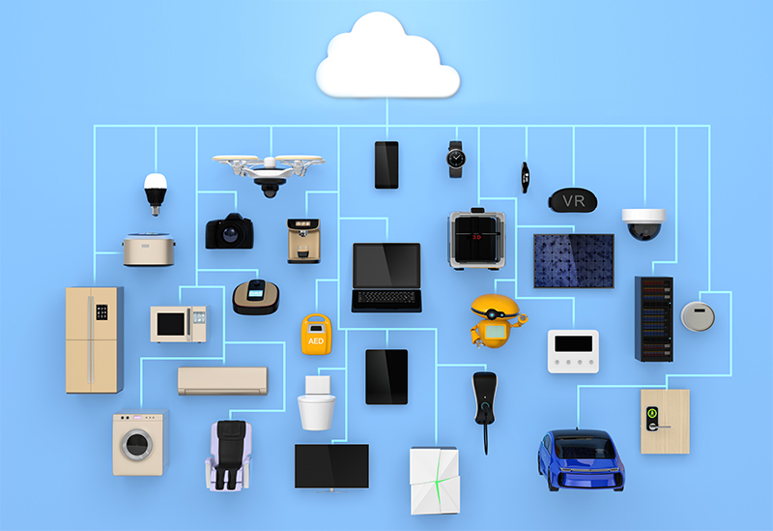
End Devices
End devices are those that provide a way for users to interact with the network. Examples include computers, smartphones and sensors.
End devices are either the source or destination of data going over the network.

Slide 11
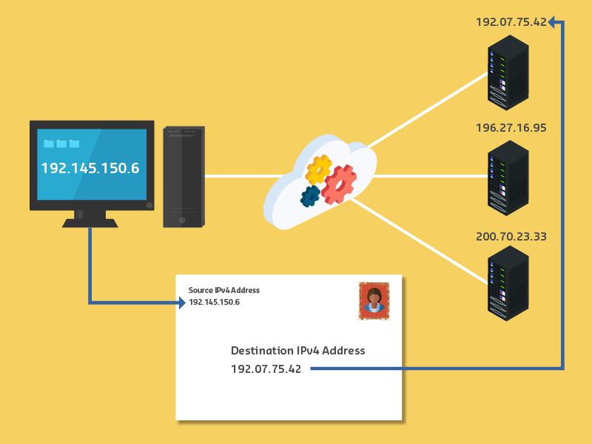
Internet protocol (IP) addresses
Every device has a unique Internet Protocol (IP) address, so it is distinguishable from all other devices. When sending a message, the IP address of the destination is used to specify where the message is being sent, similar to the address printed on the envelope of a letter.

Slide 12
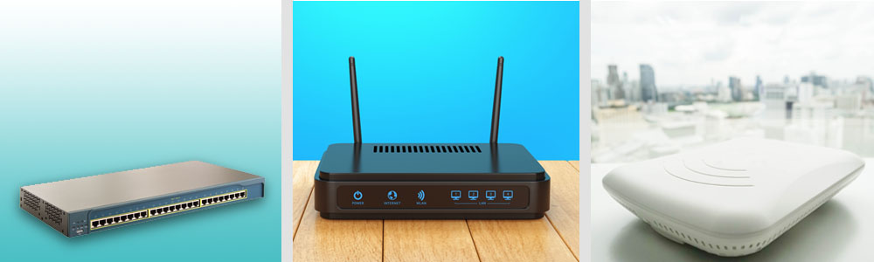
Intermediary devices
Intermediary devices interconnect end devices; host to the network, and networks to other networks. Intermediary devices also manage the data through the network
These devices take the destination host address and combine that with information about network connectedness to decide on the path that messages take through the network. Intermediary devices therefore need to maintain network information (frequently update the network map) and may also notify other devices of errors. This allows them to choose alternative pathways, or retransmit data, or even deny the flow of data based on security settings.

Slide 13
IP addresses
The addresses used to send data in networks are called Internet Protocol (IP) addresses. Ipv4 (version 4) is what is typically in use currently.
Ipv4 addresses consist of four sets of numbers separated by periods, and each number is between 0 - 255.
For example: 1.2.3.4 or 233.67.151.3
Ipv6 is being developed using six sets of numbers, colons and hexadecimal numbering to allow many more destination addresses. These will help to facilitate IoT, as well as adding features for improved routing, security and data flow.
Ipv4 has around 4 billion IP addresses (which ran out a few years back.) Ipv6 (128 bits) has around 340 undecillion IP addresses - that's 340,000,000,000,000,000,000,000,000,000,000,000,000, give or take a few billion.

Slide 14
Mobile device addresses Example
Android
For Android devices connected to either Wi-Fi or a 4G network, all address information is typically found from Settings > About > Phone Identity
If connected to a just a Wi-Fi network, then your Android phone’s IP address can be found by Settings > Wi-Fi > then touch the network that you are connected to.
iPhone
Similarly for an iPhone connected to Wi-Fi it is through Settings > Wi-Fi, then tap on the connected network to see IP address, Subnet Mask and Router addresses.
Other information on iPhone is viewable through Settings > General > About.

Slide 15
IPv4 Addresses
An IPv4 address is a 32-bit value.
For humans to easily refer to an IPv4 address, it is divided into four groups of 8 bits (octets).
Each octet is converted to decimal.
The four decimal values are separated by a 'dot' (period/full stop) in a format called 'dotted-decimal'.
Some example dotted-decimal IPv4 addresses are:
10.0.122.57
172.16.11.202
192.168.100.4

Slide 16
MAC address
The MAC address of a device is a unique identifier assigned to network interface controllers
It can also be referred as the hardware address, or physical address.
This address is used by most IEEE 802 standard network technologies, such as Ethernet, Wi-Fi, and Bluetooth.
48 bits, 12 hexadecimal integers, presented in a number of formats.
Usually tied to a device
Have two parts: the manufacturer UOI, and the device ID portion
Addresses typically fixed and not configured by the user
The standard (IEEE 802) format for printing MAC-48 addresses in human-friendly form is six groups of two hexadecimal digits, separated by hyphens (-);
e.g. 01-23-45-67-89-ab.

Slide 17
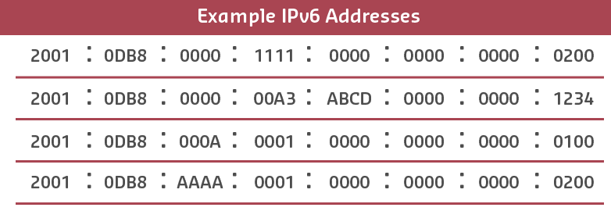
IPv6 addresses
An IPv6 address is a 128-bit value (remember IPv4 was 32 bit).
Accordingly, IPv6 provides significantly more addresses than IPv4.
For humans to easily refer to an IPv6 address, every 4 bits is represented by a single hexadecimal digit.
This gives a total of 32 hexadecimal values, presented as eight groups of 16 bits (eight hextets).

Slide 18
Domain Name Servers (DNS)
Domain Name Service or DNS, which is the Internet equivalent of a telephone book. It matches a name (like facebook.com) to a number (like 157.240.8.35) - because humans prefer to deal with names and computers prefer numbers.
The DNS is a large database of computer names and their internet addresses, but it is spread out so that no server has all the information.
If a computer requests a domain name and that server doesn’t have it, it forwards the request to another DNS server. The Domain Name Service has a hierarchical structure, so requests get sent from the bottom up.

Slide 19
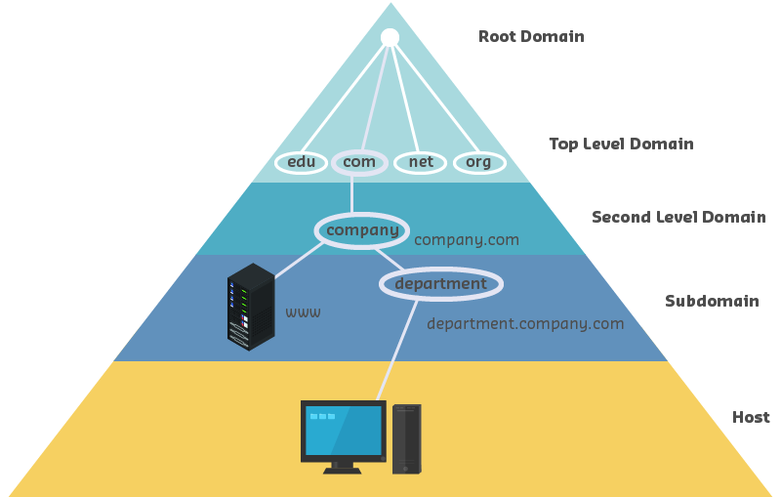
DNS hierarchy
Notes:
https://technet.microsoft.com/ens/library/2005.01.howitworksdns.aspx

Slide 20
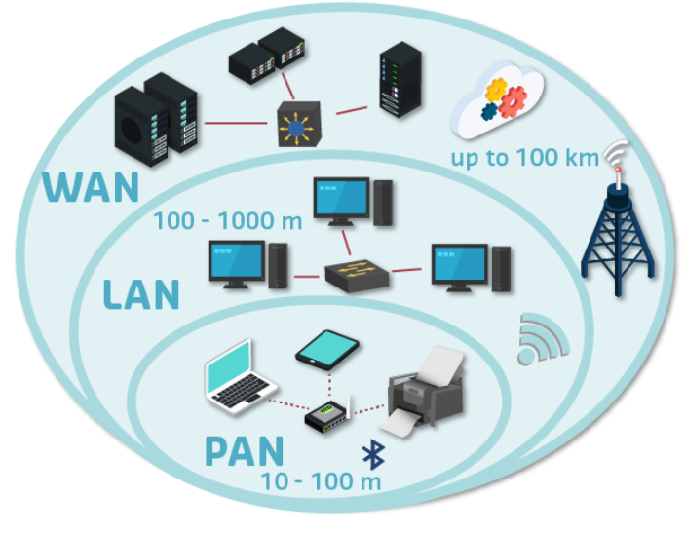
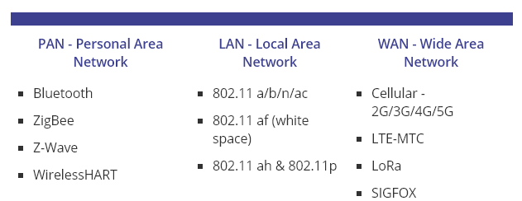
Wireless network
Notes:
Zigbee is an IEEE 802.15.4-based specification for a suite of high-level communication protocols used to create personal area networks with small, low-power digital radios, such as for home automation, medical device data collection, and other low-power low-bandwidth needs, designed for small scale projects which need wireless connection. Hence, Zigbee is a low-power, low data rate, and close proximity (i.e., personal area) wireless ad hoc network.
Z-Wave is a wireless communications protocol used primarily for home automation. It is a mesh network using low-energy radio waves to communicate from appliance to appliance
802.11 : Wi-Fi
LTE: Long Term Evolution (standard technology for 4G)

Slide 21
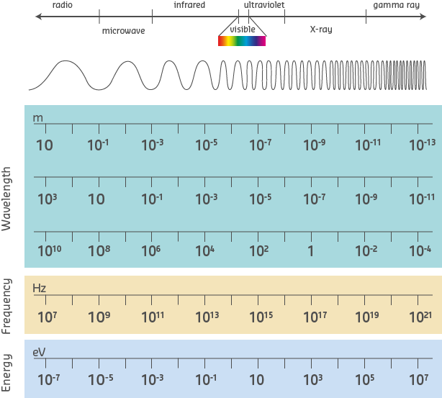
Mobile Wireless Technology
Wireless technologies use electromagnetic waves to carry information between devices.
waves have a frequency and wavelength
Radio waves are the waves of the spectrum that have the longest wavelength and the shortest frequency.

Slide 22
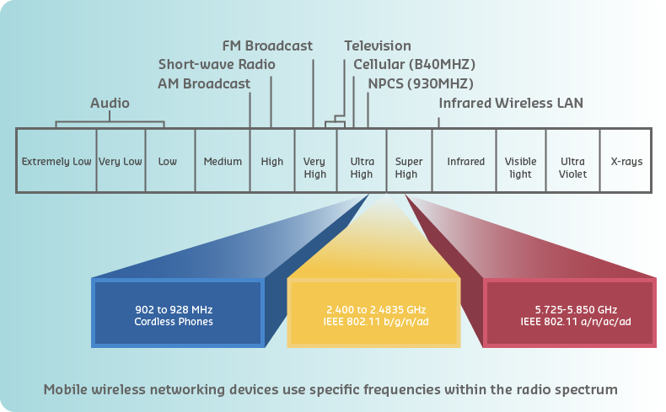
Wireless Technology
The wireless technologies most frequently used in local and personal area networks are in the unlicensed 2.4 GHz and 5 GHz frequency ranges.

Slide 23
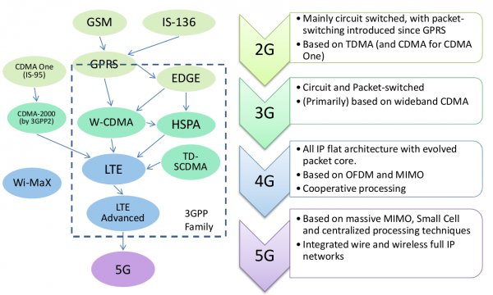
Cellular data wireless systems
Cell phone and data technologies have been labelled in ‘generations’ - G1, G2, G3, G4, and G5 - but these are just marketing names for groups of technologies, not specified standards.

Slide 24
Wifi
Wi-Fi refers to the group of radio frequency (RF) standards used to provide data communications on a Wireless Local Area Network (WLAN).
Wi-Fi operates in the unlicensed 2.4 and 5 Gigahertz (Ghz) ranges of the RF spectrum.

Slide 25
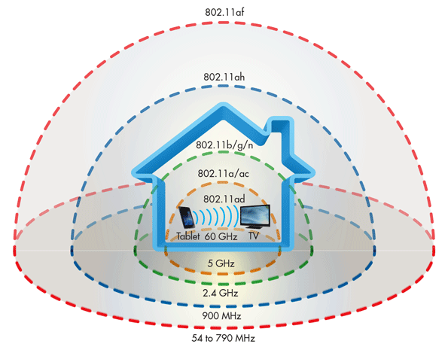
Wi-Fi standards

Slide 26
Bluetooth
Bluetooth is a low power, short range (typically less than 10 m up to 100 m. It enables mobile devices to connect to each other, and to wireless accessories, with minimal configuration.
Bluetooth Low Energy (BLE) is used in healthcare, fitness, beacons, security, and home entertainment applications.
Some examples of how devices use Bluetooth include:
Hands-free headset
Keyboard or mouse
Stereo control
Car hands-free speakerphone
Tethering (network connection sharing)
Mobile speaker.

Slide 27
NFC
Near-field communication (NFC) is a set of communication protocols that enable two electronic devices - typically portable devices such as smartphones - to establish low-speed communication by bringing them within 4 cm of each other.
NFC devices are used in contactless payment systems, like those used in credit cards and electronic ticket smartcards. NFC-enabled devices can act as electronic identity documents and keycards.

Slide 28
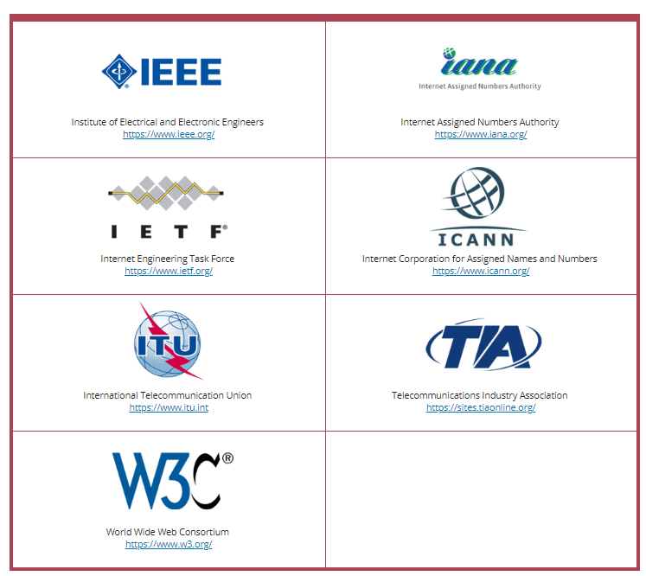
Internet standards organizations

Slide 29
Layered network models
This layered framework or structure assists with:
Understanding how both the parts, and the whole, of networks operate;
The development of new networking features and processes; and
Troubleshooting network problems by separating the processes to simplify fault-finding.
One common model is TCP/IP

Slide 30
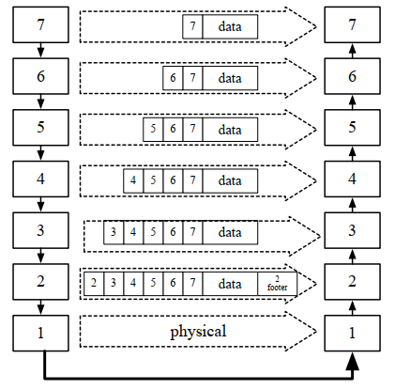
Review data encapsulation

Slide 31
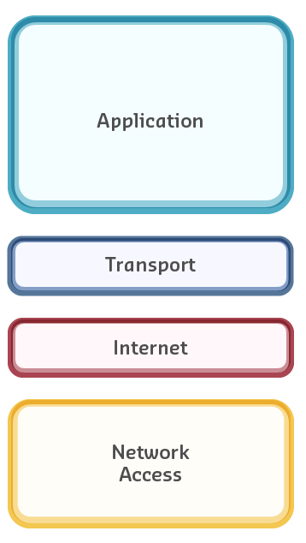
TCP/IP model (Protocol)
The TCP/IP (Transport Control Protocol/Internet Protocol) layered model implements the partitioning and abstraction principles of the OSI model, as applied to a specific suite of protocols.

